Slide 1
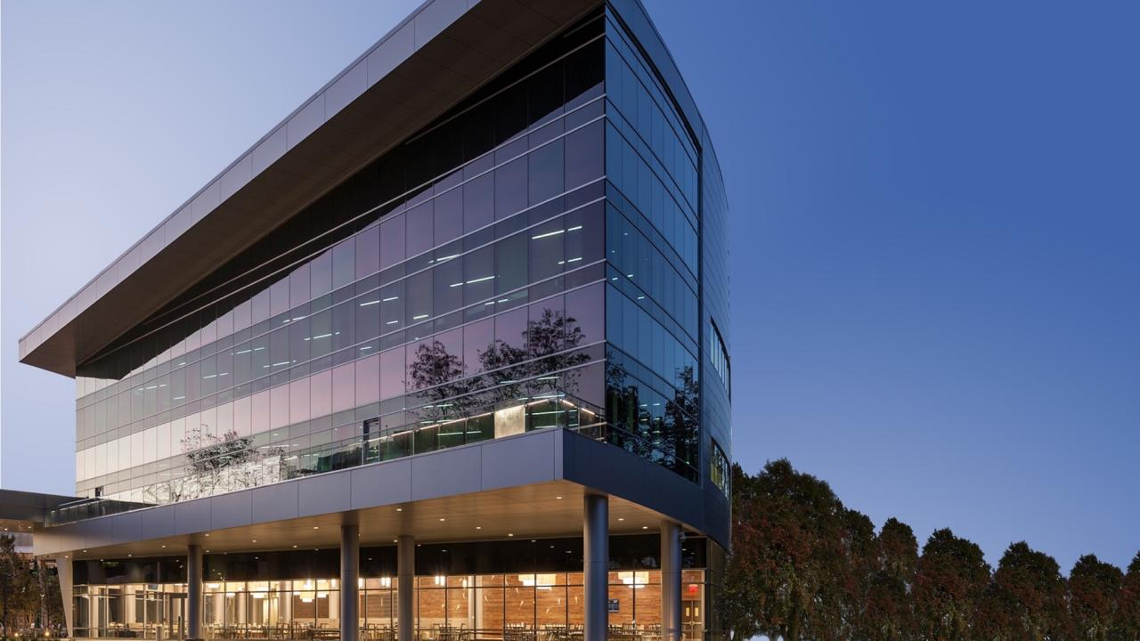

Dynamic
Electrochromic
Facades
1

Slide 2
Credit(s) earned on completion of this course
Course participants must self-report their activities by logging in to My Credentials at
http://www.usgbc.org/account/credentials.
This course is registered with GBCI for continuing professional education. As such, it does not include content that may be deemed or construed to be an approval or endorsement by the GBCI of any material of construction or any method or manner of handling, using, distributing, or dealing in any material or product.
2

Slide 3
Course description
Dynamic electrochromic facades change tint between clear and dark on demand, providing unprecedented control over the amount of light and heat that enter a building. This dynamic control results in reduced energy consumption, reduced peak load & HVAC equipment downsizing, and the elimination of blinds and shades providing unobstructed views, an increase in natural daylight and improved occupant comfort as well as productivity.
3

Slide 4
Learning objectives
Understand the impact of dynamic electrochromic glazing (EC glazing) and how it can be used to solve the competing challenge of daylight and thermal comfort along with views for health and wellness
Analyze the energy performance and human factor benefits of a dynamic electrochromic façade solution through case studies
Potential contribution of EC Glazing to LEED Rating System & material transparency credits
Explain how dynamic electrochromic glazing solutions have been incorporated into projects to solve design challenges and payback on human factors
4

Slide 5
Agenda
01
Introduction
02
Product and Benefits
03
Sustainability
04
Case Studies

Slide 6
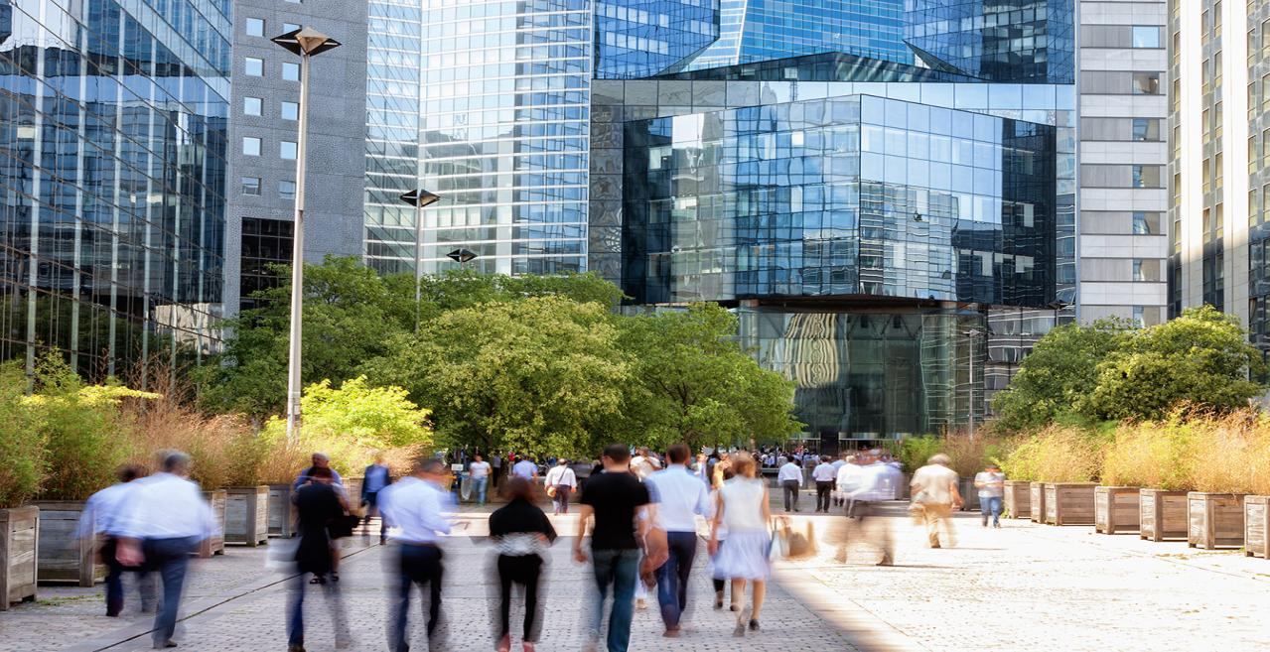
“Architecture is really about well-being. I think that people want to feel good in a space.”
Zaha Hadid
6
Notes:
Why did we create this product? To answer this let’s start with why we design buildings – at the basic level is to provide shelter. It is improve the quality of human life in it so we can enjoy our lives fully.

Slide 7

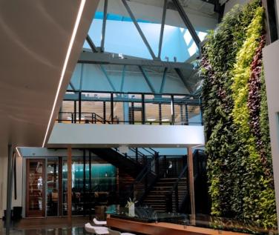

Three mega trends shaping design
Health and wellness
Sustainability and energy efficiency
Smart and Connected
7
Notes:
In other words building are designed for people – trends on design on increasingly shaped by people’s health and wellness, energy efficiency and technology

Slide 8
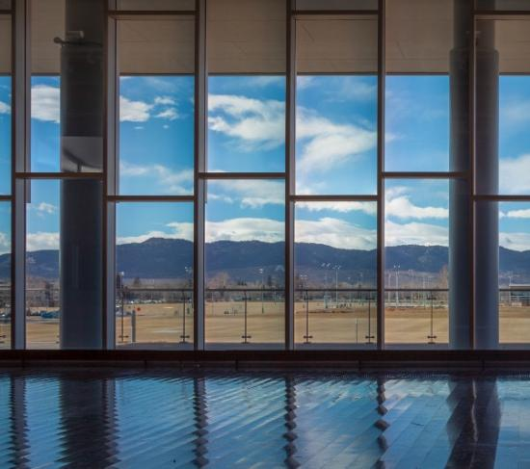
Daylight is the most requested design element
46min
More Sleep²
15%
More Time on Work³
No.1
Most
Requested
Design
Element¹
15%
More creative⁴
6.5%
Fewer Sick Days⁵
1.Global Human Spaces Report. Human Spaces. 2015
2.Impact of Windows and Daylight Exposure on Overall Health and Sleep Quality of Office Workers: A Case-Control Pilot Study, Boubekri, 2014
3.Daylight and Productivity- A Possible Link to Circadian Regulation - Figueiro 2014
4.Global Impact of Biophilic Design in the Workspace, Browning, 2015
5.Daylighting-Bias and Biophilia: Quantifying the Impact of Daylighting on Occupant Health- Elzeyadi 2011
8

Slide 9

We’re naturally drawn to daylight
Expansive views connect us to the outdoors
9
9
Notes:
To maximize natural light, building are designed with high WWR, which connect us to outdoors and provide a beautiful view

Slide 10



But the sun’s heat also causes glare and discomfort
Shades turns windows into walls
10
10
Notes:
Animated slide (play in full screen)

Slide 11
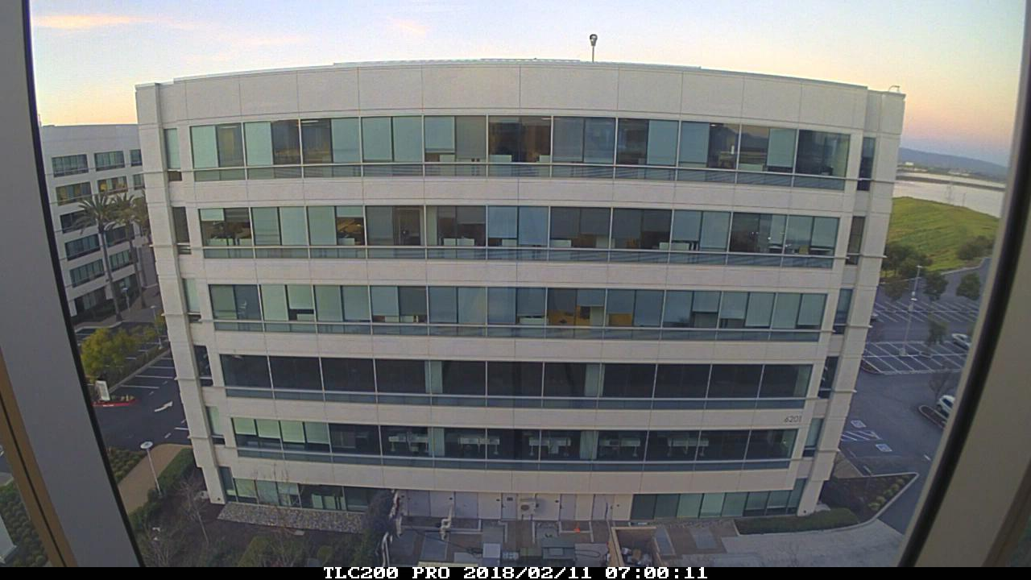
Traditional façade shading solutions
60%
of window
area covered
by shades
77%
of shades
did not
move at all
< 2%
of shades
moved
each day
Notes:
Video embedded

Slide 12
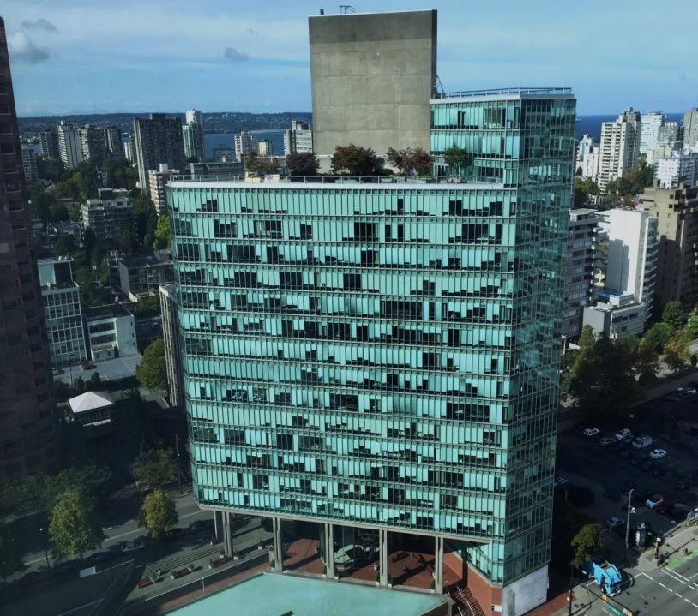
Once shades are down, they stay down
The problem is obvious
59%
covered
Source: Urban Green Council, the U.S. Green Building Council of New York, December 2013

Slide 13
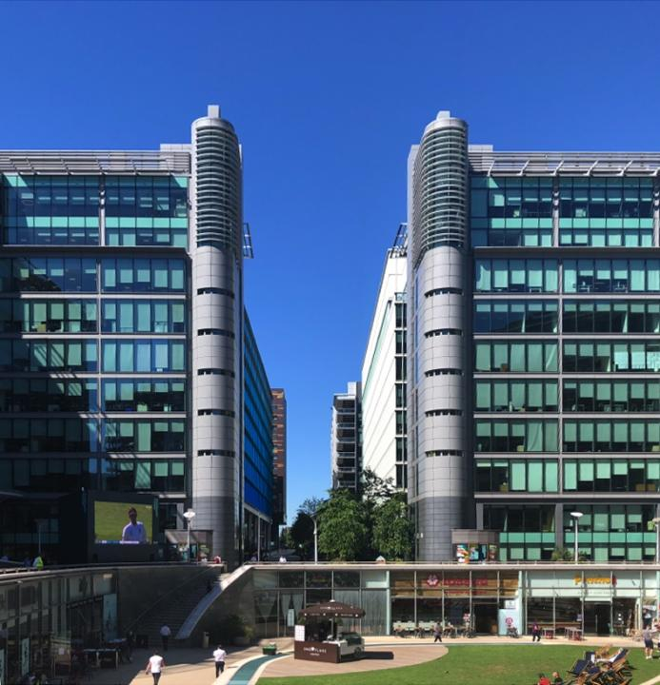
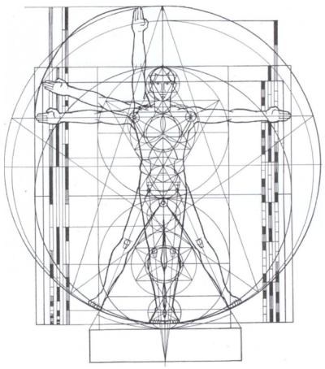
Buildings lack intelligence
Humans
Buildings
Brain
Integrated
senses:
  Touch
  Hear
  See
  Taste
  Smell
No brain
No integrated senses
13

Slide 14
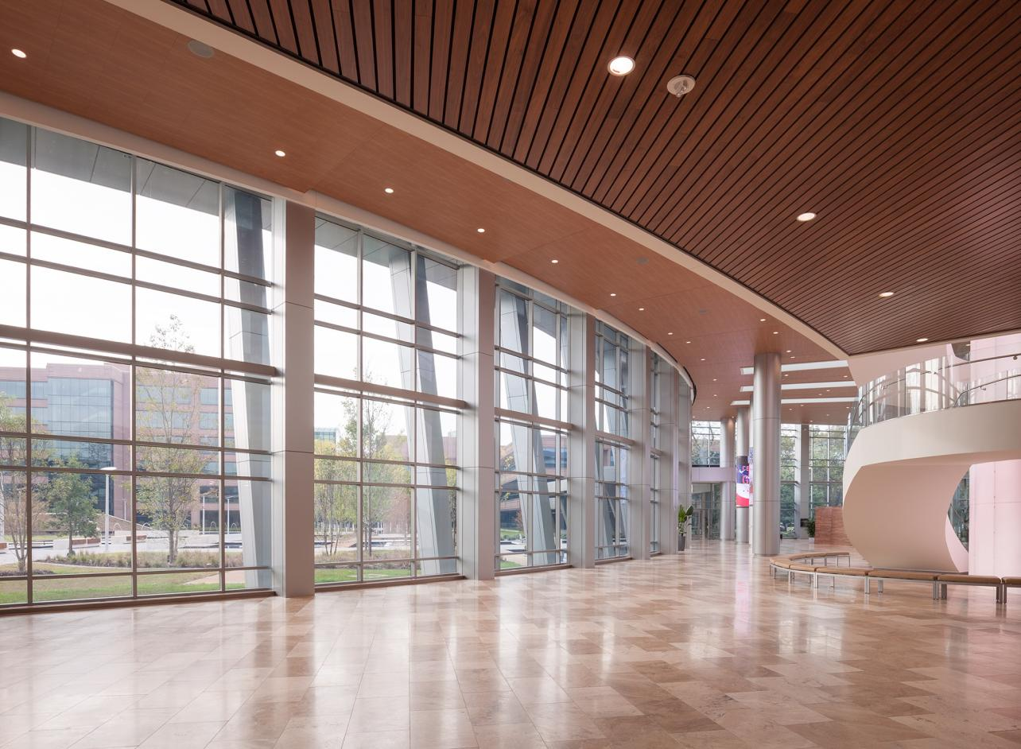
What if you could have glass that is
clear when you want it
14
Notes:
Enter EC glazing… we solve this problem. We eliminated unwanted heat and glare while still preserving the views and eliminating shades.

Slide 15
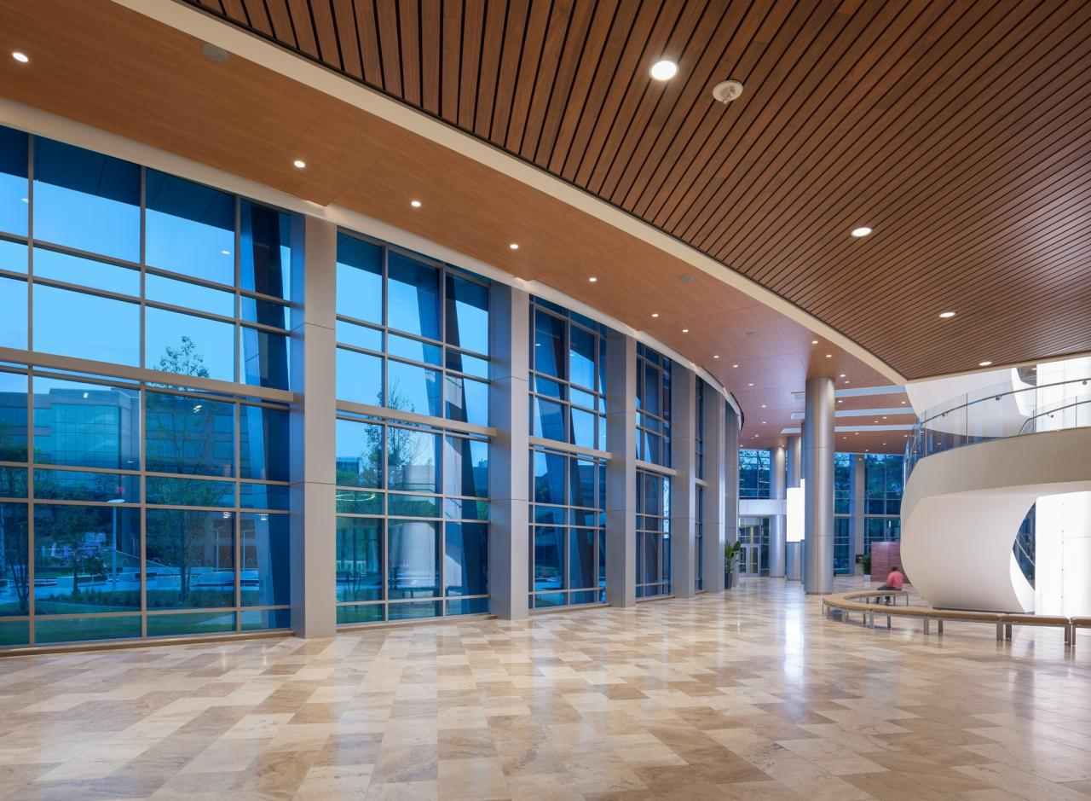
and tints when you need it
15

Slide 16
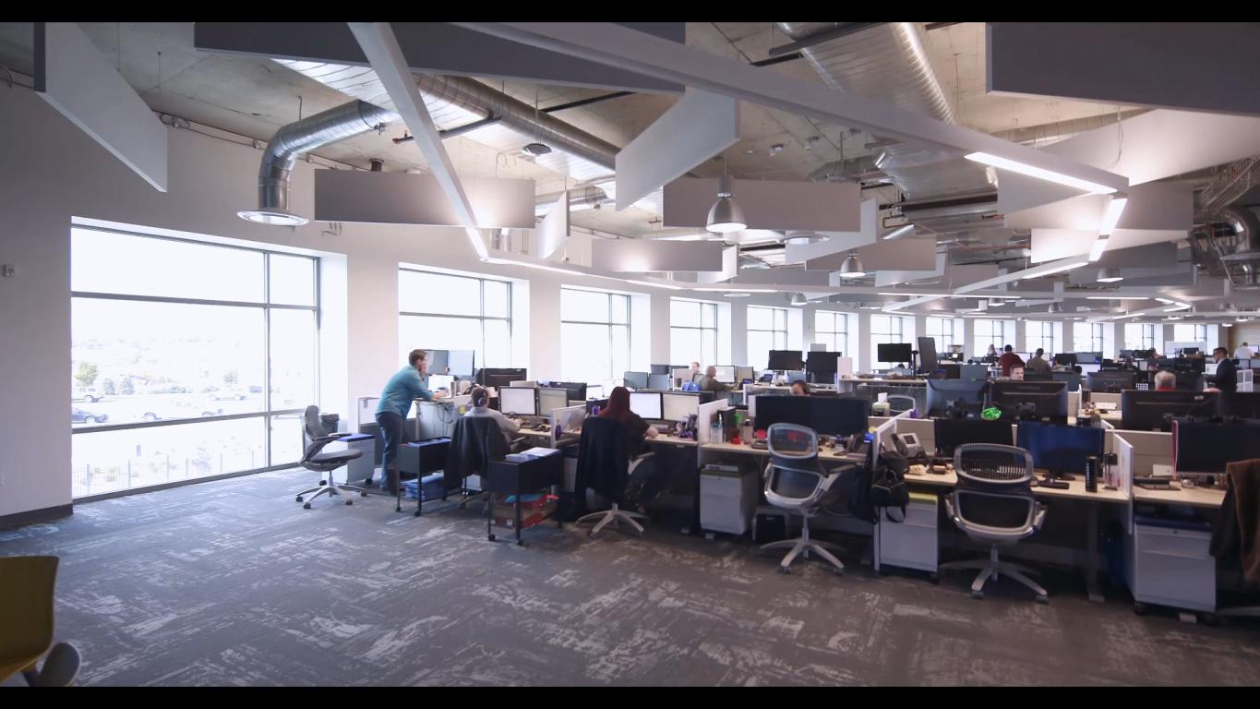
Maximizing occupant well-being
Notes:
This is how it transitions intelligently to maximize occupant comfort – (video embedded)

Slide 17
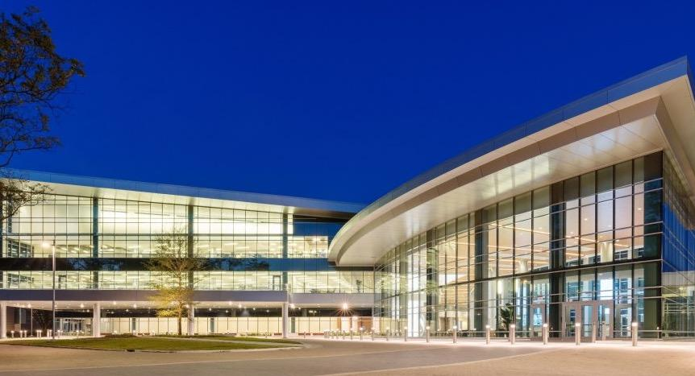
Design with freedom, incorporate more
natural light & increase glass area regardless of orientation
Flexible
Design
Notes:
The technology offer you flexible design

Slide 18

Provide unobstructed views with more daylight,
controlled glare, and greater thermal comfort
Enhanced
Health and wellness
Notes:
Enhanced health and wellness

Slide 19
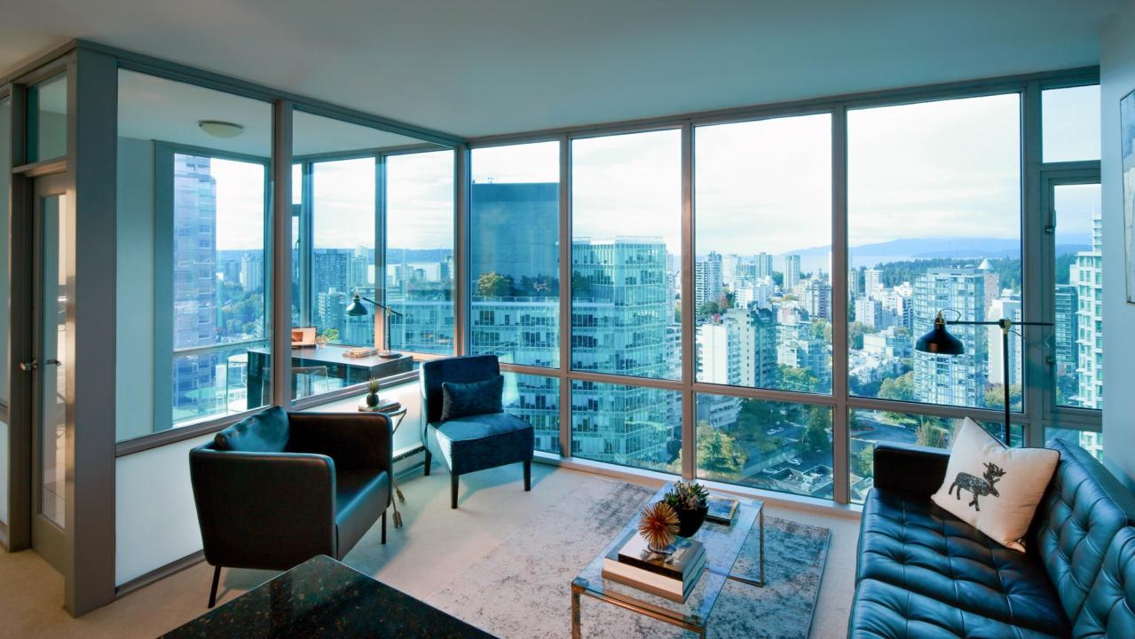
Contribute to LEED under 5 different
categories and promote material transparency
Sustainable
Solution
Notes:
And is a sustainable solution. We meet all of today’s material transparency certifications and are recognized by both LEED and WELL rating systems for green and healthy buildings. This is a project in Vancouver Canada where we were able to eliminate the whole HVAC system

Slide 20
Agenda
01
Introduction
02
Product and Benefits
03
Sustainability
04
Case Studies

Slide 21
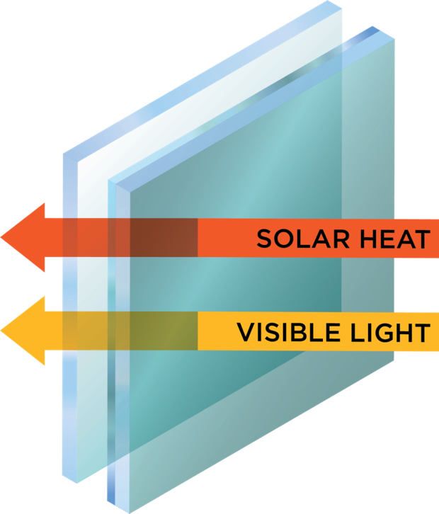
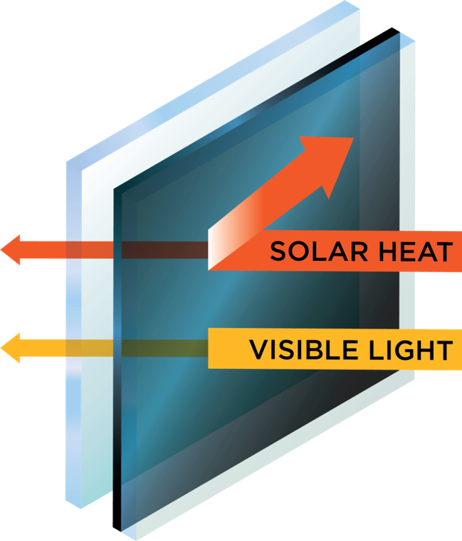
How the Glass works
TC 02
EC 02
IC
EC 01
TC 01
Glass
Solid-state coating with nano-layers of metal oxides
Small electrical
voltage changes states between clear and tint

Slide 22
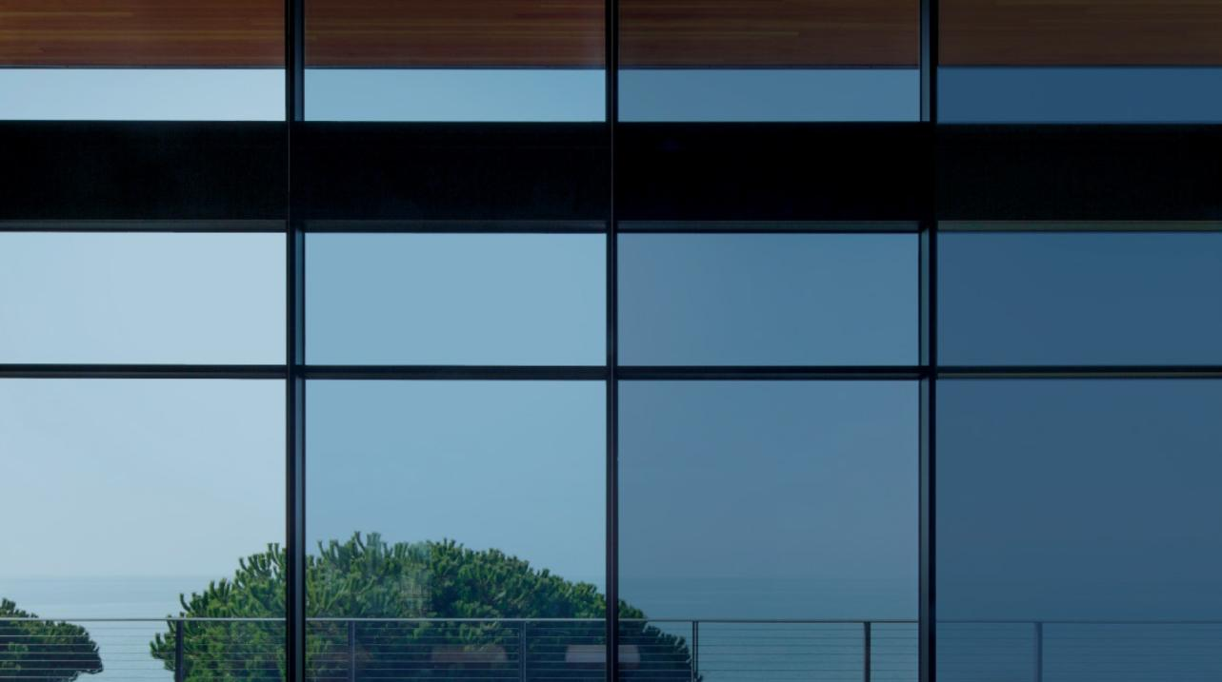
Dynamic Glass intelligently changes tint
Tvis
SHGC
58%
0.41
40%
0.28
6%
0.11
1%
0.09
COG U value – 0.29 Btu/Hr.-Ft-F

Slide 23
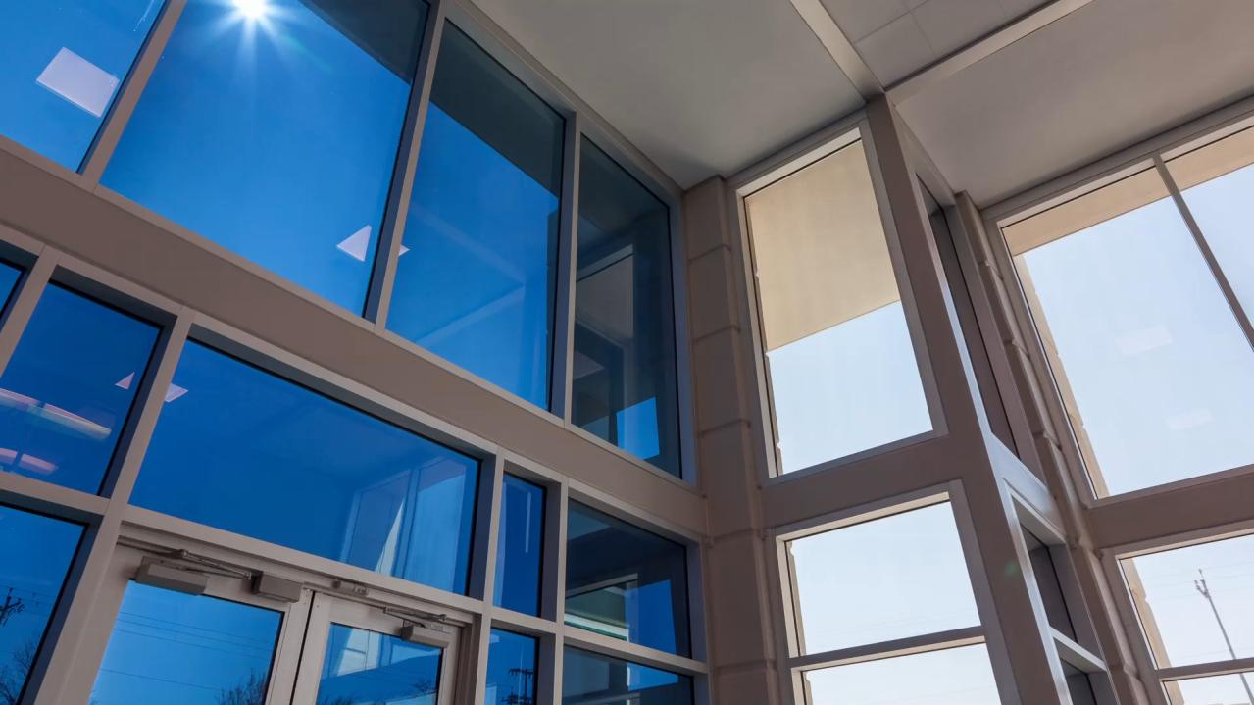
Notes:
Video embedded – explain the tint transition
In 2012, View invented the first and only predictive control for dynamic glass, View Intelligence®. With Intelligence®, your windows respond predictively with no occupant intervention, meaning occupants enjoy the views and daylight without lifting a finger. In order to maximize occupant comfort, View Intelligence® considers everything about a building: where an occupant sits, the usage of the space, the physical geometry, and the external weather

Slide 24
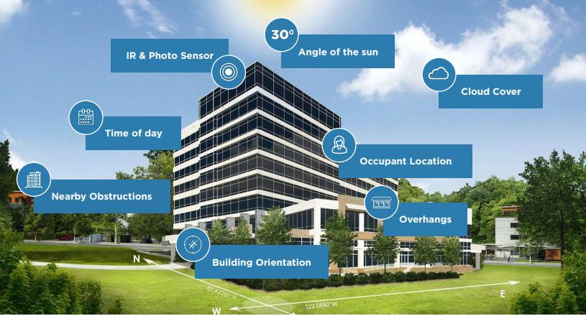
How it Works
Intelligence gathers inputs to predictively control the space for increased occupant delight

Slide 25
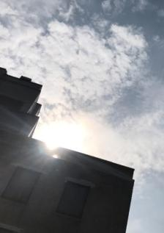
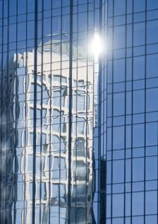
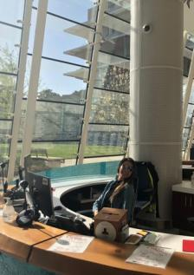
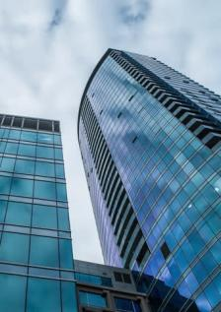
Intelligent Control Requirements
3D Model Based
Sensor based
Anticipate the Sun’s Movement
Provide Glare Control from Reflections
Be Aware of Occupant Position
Monitor Weather Conditions

Slide 26
Agenda
01
Introduction
02
Product and Benefits
03
Sustainability
04
Case Studies

Slide 27



Material Transparency
View Dynamic Glass is committed to transparent materials disclosure and provides full disclosure of intentional ingredients through the Environmental and Health Product Declaration Collaboratives.
View Dynamic Glass also maintains an LBC compliant declaration status via the Living Building Future Declare protocol

Slide 28






LEED v4 New Construction Credit Summary
LEED Certification Levels
Credit Category | Point Contribution
 | Yes | Conditional
Energy & Atmosphere | 1 - 4 | -
Indoor Environmental Quality | 2 - 3 | 2
Materials & Resources | - | 2
Innovation | 1 | 1
Integrative Process | - | 1
Total | 4 - 7 | 6
40-49 Points
50-59 Points
60-79 Points
80-110 Points
Electrochromic Glazing can contribute additional LEED points under 5 different categories
28
Notes:
*Points depends on the actual scorecard

Slide 29
View Glass - LEED v4 NC Credit Summary
Credit Category | Credit | Summary Notes
Integrative Process | Integrative Process | Both energy & water related systems must be analyzed in order to achieve this credit EC Glazing must be considered at the pre design stage as an envelope attribute This credit cannot be achieved by using Dynamic Glazing alone
Energy and Atmosphere | Optimize Energy Performance | Two energy models are required for EAc2 Option 1 Proposed design must be compared with a ASHRAE 90.1 2010 baseline model Energy Models must include all energy end uses ( such as exterior lights, elevators, office equipment etc.) in the building EC Glazing contribution will depend on other energy efficiency measures already applied in proposed design
Materials & Resources | Building Product Disclosure & Optimization – EPD|Material Ingredients | View Dynamic Glass has 3rd party verified EPD, Declare label & HPD This credit cannot be achieved by using Dynamic Glazing alone and requires minimum 20 products with EPD & HPD
Indoor Environmental Quality | Thermal Comfort | EC Glazing can help with the thermal comfort assessment by reducing solar loads The requirement is that the proposed HVAC system must maintain indoor conditions as per ASHRAE 55 This credit also requires individual thermal comfort controls for occupants like thermostat, humidifier, ceiling fans
29

Slide 30
View Glass- LEED v4 NC Credit Summary
Credit Category | Credit | Summary Notes
Indoor Environmental Quality | Daylight | Dynamic Glazing is accepted by USGBC as an automated dynamic façade system and so there is an exemption from calculating the annual sunlight exposure (ASE). Also, LEED does not allow modelling of manual internal blinds when simulating for ASE so it makes it very difficult for a project to get the full 3 points for Daylight with standard static glass. View can help achieve full 3 points depending on window-wall ratio
Indoor Environmental Quality | Quality Views | Can potentially contribute for this credit as dynamic glazing offers unobstructed views without blinds & does not distort color balance *
Innovation | (Pilot Credit) Bird Collision Deterrence | Requires all materials on the building façade to have a Threat Factor of 15 or below; exterior building fixtures that are not necessary for safety, building entrances, and circulation shall be automatically shut off from midnight until 6 a.m. & a Performance Monitoring Plan View Dynamic Glass is available in two different bird-friendly patterns – Box & Line, both of which have been tested and certified by the American Bird Conservancy
Innovation | Exemplary Performance | Achieving double the credit requirements or the next incremental % threshold Only possible credit is EAc2 Optimize Energy Performance. Depends on all other applied efficiency measures in proposed design
30
* Project Teams can submit : Supporting Documentation

Slide 31
Agenda
01
Introduction
02
Product and Benefits
03
Sustainability
04
Case Studies

Slide 32
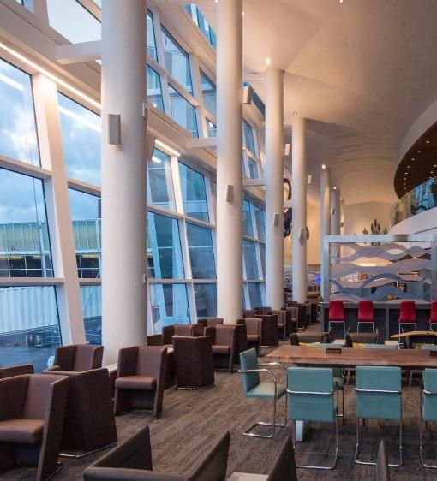
DFW Airport Occupant Study

Slide 33
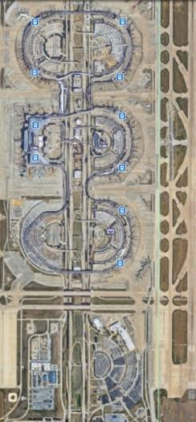
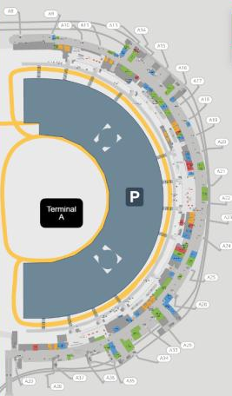
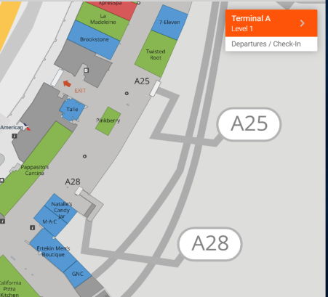
Site – DFW Airport (Dallas, TX)
Terminal A
North
South
East

Slide 34

DFW Airport Study
Purpose:
To understand the impact of daylight, glare & access to views on airport customers’ comfort by surveying participants at a gate with Dynamic Glass and a gate with no Dynamic Glass
Location:
Dallas Fort Worth Airport- Gate A-25 (Low-E) & Gate A-28 (EC Glazing)
Duration:
5 week study (September 25th - October 31st 2017) from 7am-11am everyday
Parameters:
Surveyed 500 participants (250 at each gate);Video Recordings everyday
Survey Content:
20 questions regarding comfort & seating priorities
Survey Integrity:
Voluntary subjects, no compensation offered
Passenger Movement:
Tracked by Airport Cameras
34
Notes:
Conclusion:
Dynamic Glass Gates have an impact to increase customers’ ability to sit comfortably compared to standard glass gates

Slide 35
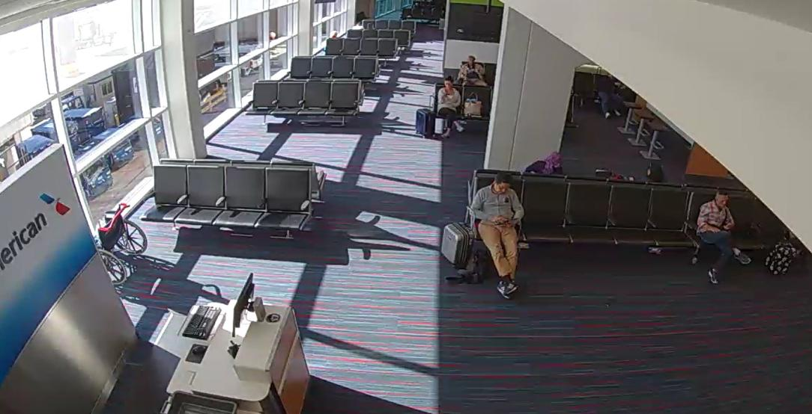
Gate A25 – SB 70 XL Low-E
Unmitigated Solar Transmission
Visual and thermal discomfort for waiting passengers
Increased cooling loads on HVAC system
Unusable seats near windows
35

Slide 36

Gate A28 – View Dynamic Glass
Controlled Solar Transmission
Thermal comfort near glazing and reduced cooling loads
No direct glare on eyes and uniform light level for device usage
Full space utilization all the way up to glazing
36

Slide 37
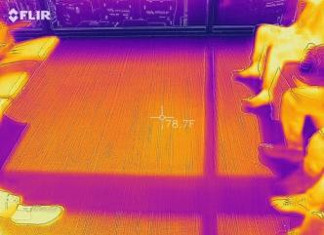
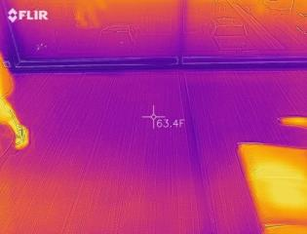
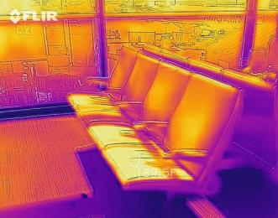
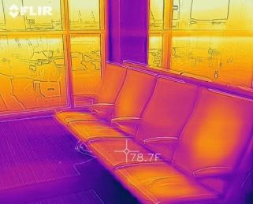
IR Temperature
Gate A25 – Low-E Glass
Oct 25
10 am
Gate A28 – EC Glass
Floor Temperatures are 15 Degrees cooler with EC Glass
78.7 ºF
63.4 ºF
Outside Conditions
Air Temperature
12.7º C (55 ºF)
Direct Normal Radiation
770 W/m2
Seats are 11 Degrees cooler with EC Glass
89.5 ºF
78.7 ºF
37

Slide 38
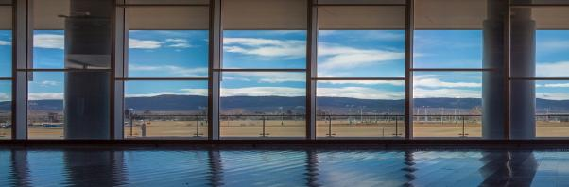



Key Findings
Hedge A. & Nou D. Electrochromic Glass Enhances the Passenger Experience in Airports.
Ergonomics International Journal 2018, 2(6).
Up to
83%
longer gate dwell time near EC glass
vs Low-E glass
2X
higher spending in restaurant with EC glass
#2
Access to views as a gate seating priority
15^{ºF}
Cooler surface temps with EC glass
38
DFW Airport Study White Paper
Notes:
In A25 both the Mean (18.5 min) and Median (13.8 min) times are shorter in Zone 1 (closest to the glass) compared to A28 zone 1 (Mean- 25.1 min) (Median- 20.4) with a count of N=171 and N=133 respectively.
In A28, Zone 1 stays average 27% longer than those in Zone 3 and 10% longer than those in zone 2. The opposite is true for A25 where stays were 26% shorter in Zone 1 than Zone 3 and 25% shorter than in Zone 2. This shows people prefer to sit by the windows when they can but heat/glare will shorten their stay.
Similar to initial results, A28 averaged 3.5 people not in a seat but by the windows while A25 only had an average of 0.75. This looks like a good statistic but I believe it is a result of the seating arrangements at the gates. People are more likely to walk between the windows and the seats at A28 and so are also more likely to stand. There also is a longer stretch of window at A28.
Desired Amenities Ranking: (5 Point Scale)
1.) Near Boarding Area (4.1)
2.) Empty Seat Next to Me (3.5)
3.) Views and Daylight (3.45)
3.) Access to Outlets (3.35)
5.) Access to bathrooms (3.2)
6.) Access to Restaurants (2.78)
7.) Access TVs (1.9)
Seating Preference
50%- Close to the Glass (less than 10 feet)
34%- Fairly Close to the Glass ( 10-25 feet)
Favorable Comments
View-43% Favorable
Control -17%
Glare:
View: 37% Reported Glare
Control: 52% Reported Glare

Slide 39
Commercial Office Thermal Comfort

Slide 40
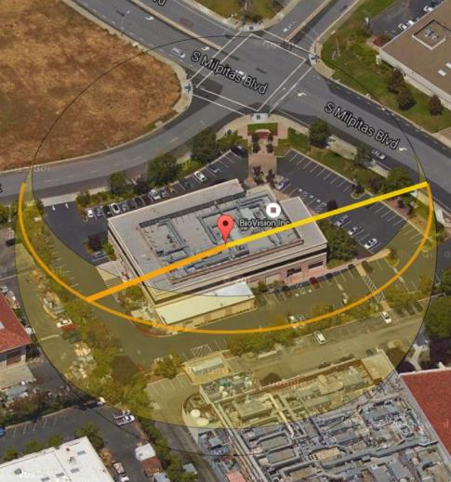
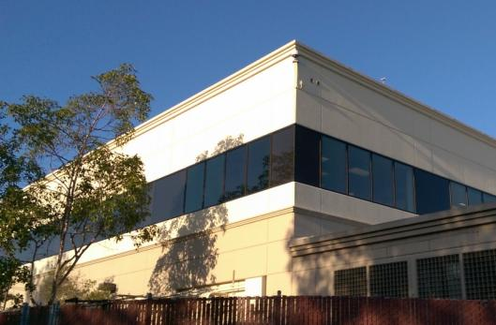
Site – Office (San Jose, CA)
South West Corner
4 pm
Objective Compare occupant thermal comfort near glazing for a private office with LowE vs EC Glazing
Observation Period
3 – 5 pm on 17th & 18th August
Outside Conditions
Air Temperature – 31ºC (89 ºF)
Direct Normal Radiation – 800 W/m2
40

Slide 41
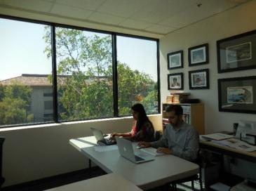
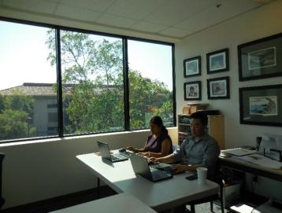
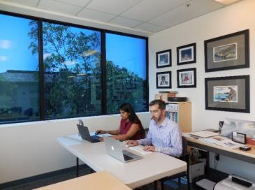
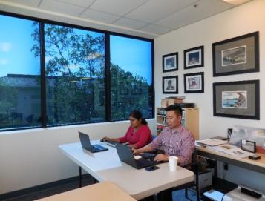
Study Design – Private Office
Subjects 1 & 2
Four Subjects
( 2 M : 2 F)
Window Orientation West
Two Positions
3.5 ft. from glass
6 ft. from glass
Two Glass Types
EC Tint1 – SHGC 0.41
(Low-E Substitute)
EC Tint 4 – SHGC 0.09
Measurements
IR Thermography
+
Comfort & Sensation survey via online app
Subjects 3 & 4
Aug 17 3 – 4 pm
Aug 17 4 – 5 pm
Aug 18 3 – 4 pm
Aug 18 4 – 5 pm
41

Slide 42
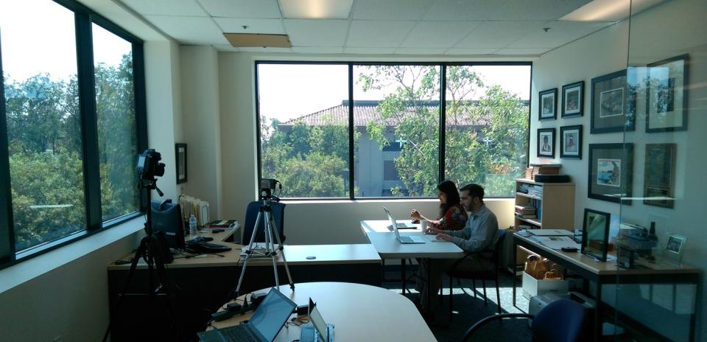


Site Setup
Blocked Ceiling Diffuser
FLIR T650 IR Camera
640 x 480 pixel IR Detector
Accuracy ± 1° C
Thermocron Data Logger
Temperature + Humidity
Accuracy 0.0625 ° C

Slide 43

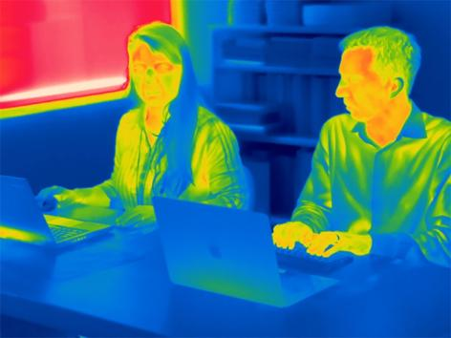
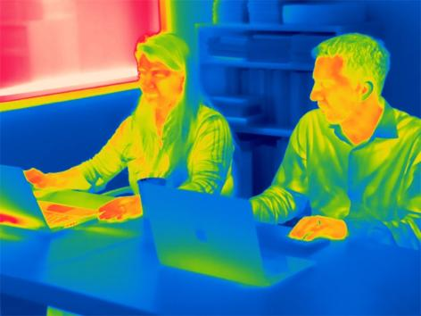
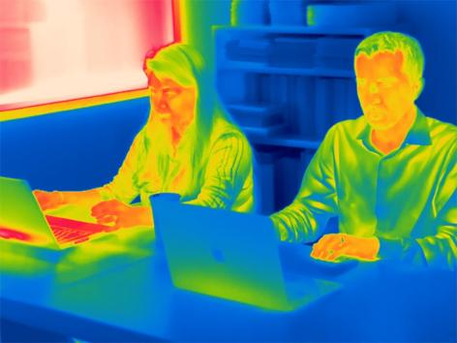
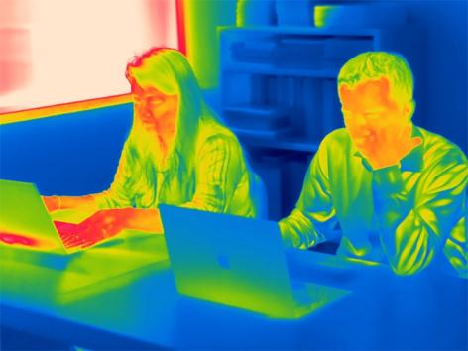
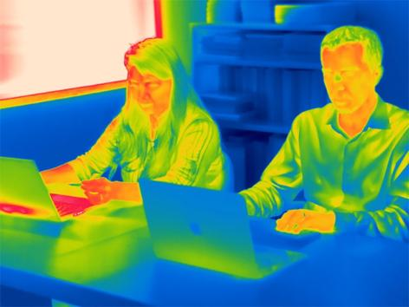
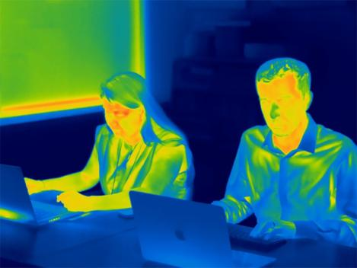
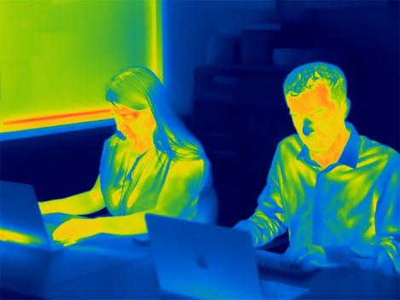
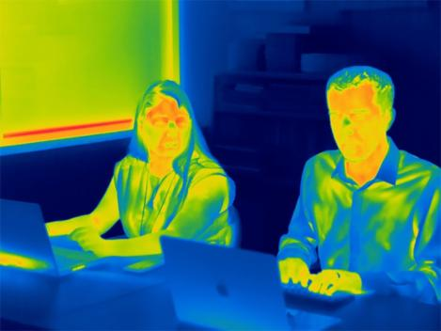
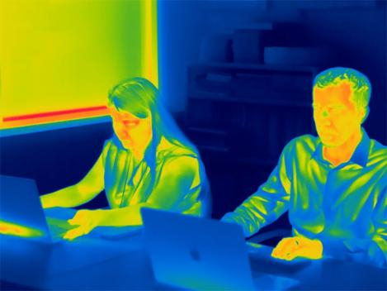
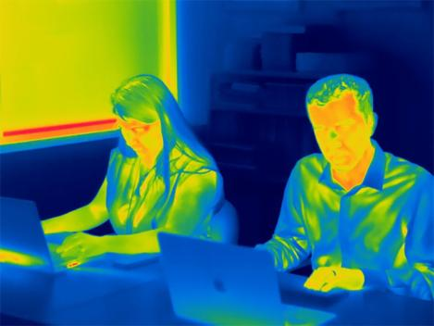
IR Temperature
3 : 00 pm
3 : 15 pm
3 : 30 pm
3 : 45 pm
4 : 00 pm
EC Tint 1 – SHGC 0.40
(Low-E Equivalent)
EC Tint 4 - SHGC 0.09
Deg F
Notes:
Animated Slide - on-click in presentation mode

Slide 44
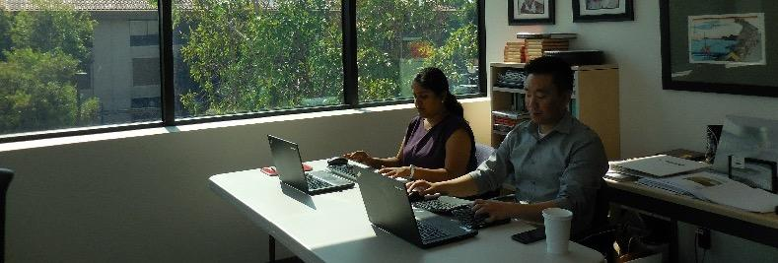

Key Findings
3^{ºF}
Lower indoor air temperature with EC
Thermal discomfort within 10 mins next to Low-E
10^{ºF}
cooler skin temperature
with EC
No discomfort after 1 hour next to EC glazing

Slide 45
Daylight &
The Workplace Study

Slide 46

Daylight & Workplace Study
Daylight & Workplace Study White Paper

Slide 47

Health benefits of EC Glazing
51%
63%
56%
Eyestrain
Headaches
Drowsiness
Research conducted by Professor Alan Hedge of Cornell University

Slide 48
Lake Union Office Building
Seattle, WA

Slide 49

Lake Union Office Building
A 90,000 sf 7-story office building was modernized by replacing the existing 1970’s era single pane glass with dynamic glazing
Weather normalized energy use was monitored from August 2014 through June 2015.
Floor to ceiling glass was installed on all facades
Existing roller shades were permanently removed
Glass is controlled using Intelligence to optimize comfort and minimize glare
LEED Gold EBOM, 2015 Visionary Award
49

Slide 50
Lake Union Office Building – Executive Summary
With Dynamic Glass Energy saved approximately 18% over a one year period¹
With targeted solar load control, View reduces simultaneous heating and cooling¹
The addition of dimmable lighting systems could further increase energy savings
Additionally, improvements the envelope should yield substantial increases in occupant thermal comfort
Lighting
use
additional lighting
savings possible
18%
energy savings
Comfort
‘significant’ increase in
occupant comfort
50
¹ ENERGY EVALUATION REPORT for Installation of VIEW Dynamic (Electrochromic)Glazing at Lake Union Building, Seattle, WA. University of Washington, 2017.

Slide 51
Alta View Hospital Study

Slide 52




Alta View Hospital Study
Purpose: Assess Dynamic Glass performance vs Low E in hospital setting
Project location: Sandy, UT
Space type: Post-partum patient rooms
Orientation: West
Dynamic Glass Product: Standard clear infill
Baseline: Clear single pane or tinted dual pane glass
Manual roller shades (5% openness factor) in all the rooms
Timeline: Aug-Oct’15
Project team
View Inc.
Intermountain Healthcare Transformation Lab
Alta View Hospital Staff
Room Type A
Dynamic glass
Static clear single pane glass
Room Type B
Dynamic glass
Static tinted dual pane glass
52

Slide 53
Purpose: Assess Dynamic Glass performance vs Low E in hospital setting
Results based on patient surveys
HCAHPS Survey Results
Nurses Visual and Thermal Comfort
Patient Visual and Thermal Comfort
“Why were shades closed?”
* HCAHPS - (the Hospital Consumer Assessment of Healthcare Providers and Systems) is a patient satisfaction survey required by CMS (the Centers for Medicare and Medicaid Services) for all hospitals in the United States. The Survey is for adult inpatients, excluding psychiatric patients.
53

Slide 54


Alta View Hospital - Shades Behavior
Real-time measured sensor data over period of the study
28 Patients
29 Patients
Blinds fully closed the same amount of time
Dynamic glass increased the amount of time blinds were mostly open (38% ➔ 58%)
54

Slide 55
Result: Standard rooms out of HVAC control and occupants too warm
Results based on pre/post surveys
Significant improvements in all categories for Dynamic glass vs. standard glass and blinds
55

Slide 56


Alta View study - Thermal Comfort Monitored Data
View vs. control room (setpoint temp and temp near patient bed)
Dynamic Glass
HVAC system is able to track occupant-set temperatures, occupants are comfortable
View glass room temperature tracks HVAC setpoint
Standard Glass
Occupants are too warm from the sun and try to set room temp cooler, but HVAC can’t keep up
Standard room temperature up to 5 °F higher than setpoint
Result: Standard rooms out of HVAC control and occupants too warm
56

Slide 57


Alta View study - HVAC Performance
Discharge Air Temperature
Dynamic Glass
HVAC discharge temperature can be up to 75°F and still maintain room setpoint temperature
Standard Glass
HVAC discharge temperature almost always needs to be 60°F and still can’t hit setpoint
Result: Occupants are more comfortable and using less energy with Dynamic Glass
57

Slide 58

Alta View Hospital Study – Summary of Results
Improved comfort and greater access to daylight versus traditional glass.
Occupants reported they were more satisfied, more comfortable, and were able to control glare without using blinds.
5°F
cooler rooms on
warm days
53%
increase in occupant access to daylight and views
73%
decrease in heat and
glare complaints
100%
of survey respondents reported no glare issues
58

Slide 59
Visual Comfort & Energy Demo Room Study

Slide 60

View Visual Comfort and Energy Study
Side-by-side south-east facing identical workplaces
Compare the energy performance and visual comfort over a period of 12 months for a commercial office room installed with Dynamic Glass.
Dimmable lighting, VAV HVAC, BMS Control
Energy monitoring
HVAC
Lighting
Visual comfort monitoring
Glare
Daylight
Low-e room:
Low-e room:
Dynamic room:
Dynamic room:
Low-e with
manual shades
Low-e with
manual shades
Intelligence control with manual
override option
Intelligence control with manual
override option
Visual Comfort White Paper

Slide 61

Physical room setup

Slide 62

Energy Performance: Annual
Average total energy savings (HVAC + lighting)
39%
average total energy savings
62
Link to the Energy Study

Slide 63

Visual comfort setup
Daylight
Glare
Daylight
Glare
HDR fisheye view used for analysis
Illuminance level of 30fc used as a metric
Measured used internal light photosensor
Artificial light contribution not accounted for during
the analysis
Daylight glare probability (DGP) used as metric
Analysis based on HDR images (taken every 30 min)
>0.45 disturbing glare threshold used in analysis
(Source: IES RP-5-13)
Illuminance level of 30fc used as a metric
Measured used internal light photosensor
Artificial light contribution not accounted for during
the analysis
Daylight glare probability (DGP) used as metric
Analysis based on HDR images (taken every 30 min)
>0.45 disturbing glare threshold used in analysis
(Source: IES RP-5-13)
63

Slide 64



Visual comfort performance
Glare control with unobstructed views and increased daylight
Dynamic Glass in tinted state with Intelligence Control
Low-e glass with shades down
Dynamic Glass
64
Low-e glass with shades up

Slide 65


















Visual comfort performance
7am
9am
11am
1pm
3pm
5pm
Low-e
Low-e with shades
Dynamic Glass
Tint 3
Tint 4
Tint 4
Tint 3
Tint 2
Tint 1
Glare
Daylight
Dynamic Glass tint level
Dynamic Glass tint level
3
4
3
2
1
3
4
3
2
1
Glare control while maximizing
daylight and views
Low-e
Additional daylight
without glare
Low-e
Disturbing glare
threshold
Daylight Glare Probability
View Dynamic Glass
View Dynamic Glass
Low-e with shades
Min. light required
Low-e with shades
7 AM
9 AM
11AM
1 PM
3 PM
5 PM
7 AM
9 AM
11AM
1 PM
3 PM
5 PM
65
Notes:
This shows an example in October where the sun angle is low on the horizon from morning to afternoon
Images are depicted for every 2hr between 7am-5pm
First set of images shows typical low-e room with shades open - the images show that the space is too bright and uncomfortable when sun is directly on the façade
While there is ample daylight in the space in this condition (graph 2), the Daylight Glare Probability (DGP) is well above the disturbing threshold making the space unusable from 9am-2pm shown by the red shaded area. No one will be able to sit a space like this with shades open
Occupants will close the shades to reduce the glare
While glare is practically eliminated when shades are closed (graph 1) , it also blocks all the useful daylight (graph 2) throughout the day . This is mainly because manual shades are rarely opened after the sun moves away from the façade in late afternoon
Images for room with View Dynamic Glass with Intelligence control. The glass goes to darkest level Tint 4 in the morning during direct sun exposure to cut the unwanted glare and then steps up to clearer states all the way to Tint 1 later in the day when sun moves away from the façade to let in daylight
Graph 1: View Dynamic Glass shows comparable glare control (DGP) as shades closed in the morning
Graph 2: View Dynamic Glass maximizes daylight in the afternoon compared to shades exceeding the minimum desired light level at the desk level. The green shaded area shows useful daylight in the space with View Dynamic Glass
View Dynamic Glass provides glare control while maximizing daylight and views
The analysis above is for a typical day in October. It shows a scenario of glare in low-e room with no shades. The glare is so high that its uncomfortable to sit in the space.
When occupants pull the shades down to cut the glare, they also block the daylight coming in the space esp. after the sun moves away. It’s a compromise.
With View Dynamic Glass, the glare is reduced by tinting the glass to darkest state. When the sun moves away from the façade, the glass goes to clearer states, thus maximizing daylight

Slide 66

Enabling the most requested
design element
Unobstructed
views
More
productive
employees
Electrochromic Glass
Healthier
and happier
people
Greener
building
Higher
returns
Notes:
To summarize, EC really enables daylight by providing all these benefits. (this completes the story)

Slide 67







Benefits for Tenants/Occupants
Optimize daylight
Control glare
Save energy
Improve thermal comfort
Increase usable floor space
Increase productivity
The cost is far outweighed by worker satisfaction. “Our annual payroll is $100 million,” CEO & Founder Patrick Byrne says. “If we can do something that makes people 2% more efficient, that’s worth $2 million [annually].”
67
Notes:
Overall benefits for occupants

Slide 68





Benefits for Landlord/Developers
Capture
higher returns
Differentiate
from competition
Eliminate
Shades
Downsize
HVAC
Gain LEED
Points
“We thought of moving out, but now we’ve extended our lease”
– Lake Union Building Tenant
Notes:
Overall benefits for landlords

Slide 69
Quiz
The quiz is designed to evaluate your understanding of the course. The passing score is 100%. Upon passing the quiz, you will have access to a PDF of certificate of completion. The quiz may be attempted multiple times if necessary. Click the below link for the quiz.
https://view.com/training/gcbi-quiz.html
69

Slide 70

Natural light is better.
That’s our view.

Slide 71




